Slide 1
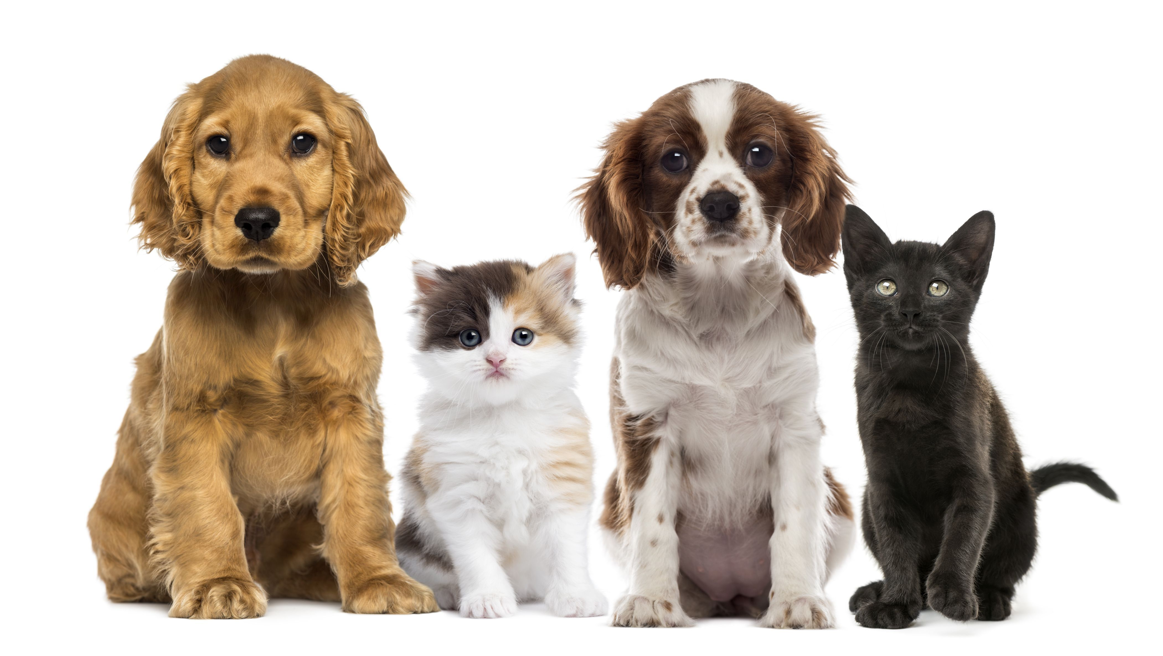
Analysis of Dog and Cat Data
By Bruno Magnani

Slide 2
Outline of the Presentation and Overview of the Data
Overall for the Dog and Cat Data, I will be analysing the data using a Top to Down approach, which can be eventually broken down to a Breed Name.
Analysis of the Dog Data
- The Data is analysed by using the Group 1 and Group 2 categories encompassing the role of the Dog Breeds.
- Insights derived by looking at the Price, Weight and Intelligence category.
- Insights derived by looking at the Temperament and Watchdog Categories.
- Summary.
Analysis of the Cat Data
- This Data is analysed by using the Lap Cat Category first with a Subcategory Fur, showing the characteristics of
each breed, its Price and Quantities Sold.
- Analysis of the Temperament of the Cats.
-Summary.
Overview of the Data
The Dog Data Set comprises of a list of Dog Breeds each with its respective functional description divided into two categories, Weight, Characteristics, Average Price, Intelligence Rating and Quantities Sold in the UK, USA(2017) and Malaysia. The Cat Data Set comprises of a list of Cat Breeds with a Lap Classification, Fur Length, Weight, Characteristics, and Quantities Sold in the UK, USA(2017) and Malaysia.

Slide 3
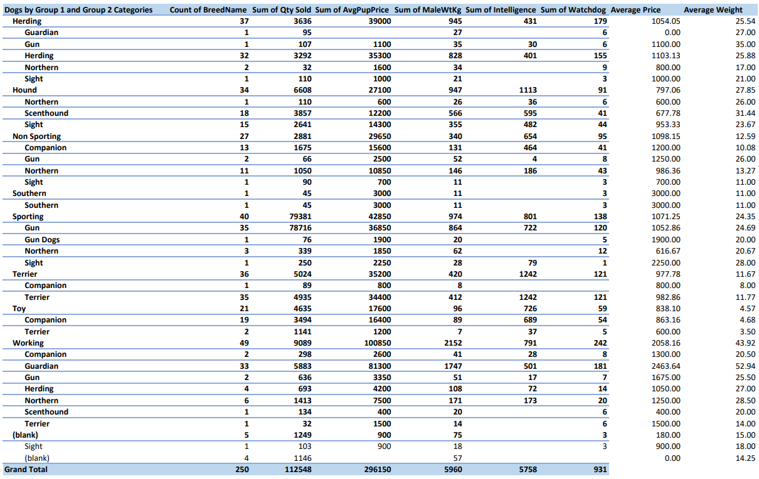
Analysis of the Dog Data
By looking at the
Group 1 Dog Classification alongside its corresponding
Group 2 Dog Classification, I have calculated their respective Total Number of Dog Breeds, Total Number of Dogs Sold, the Sums of Average Pup Price, Male Weight in Kg, Intelligence and Watchdog, which are opposite.

Slide 4
Analysis of the Dog Data Continued
As we can see in the Working Category from Group 1 when paired with corresponding categories in Group 2, it is evident that the highest number of Dog Breeds are in the Working Guardian Category and this translates to the most number of dogs sold in the Working Category totalling 5883. Already customer purchasing preferences show that when they purchase a Working Dog it is for guarding purposes. This is followed in second place by the Working Northern Dog, which is bred to resemble a Wolf. The customers were also purchasing Working Herding Dogs and Working Gun Dogs. Gun Dogs are used to assist Hunters to find and retrieve Game and come in three primary types which are Retrievers, Flushing Dogs and Pointing Breeds. Working Herding Dogs are used in animal farming.
The Sporting Category is where the most popular type of Dog is found selling a total of 79381 dogs. The “Sporting Gun” Dog sold a total of 78716, representing 69.94% of the total number of dogs sold. The likely reason for the purchase of this type of Dog is for hunting purposes.
In the Herding Category, the dog breeds most represented are mainly for herding purposes with 3292 dogs sold, being 2.92% of the total number of dogs sold and are the most expensive in this category costing an average of £1103.13 per breed. They also weigh the most, prompting a correlation between the role of the dog and its weight, which will be reflected in its price.
For the Hound Category, purchases were predominantly made for Scent Hounds and Sight Hounds. It seems like Scent Hounds are used in the Police Force, the Army and in Hunting. Sight Hounds are used for the blind and sight impaired.
In the Non-Sporting Section, purchases were made for Companion and Northern Dogs, which were the most expensive and weighed the most in this category.
As far as the Terrier Group is concerned, purchases were made for companionship reasons and for specifically buying a Terrier, which was reflected in the highest number of dogs sold in this category. Terriers are generally bred to hunt vermin.
In the Toy Category, most of the dogs sold were for companionship reasons and then secondly because they wanted to buy a Terrier.

Slide 5
Analysis of Dog Data continued
Group 1 | Group 2
Herding | Herding
Hound | Scenthound
Hound | Sight
Non Sporting | Companion
Sporting | Gun
Terrier | Terrier
Toy | Companion
Working | Guardian
By analysing the Intelligence parameter we notice that there is a three way correlation between Price, Weight and Intelligence. Therefore, a Dog that weighs more and is more intelligent carries a higher price. This is particularly apparent in the following categories:
Apart from the Non-Sporting Companion Dog they seem to be mainly used for Animal Farming, in the Army/Police Force, as Guide Dogs for the Blind, in Hunting Sports and for Domestic purposes such as hunting Vermin. The buying trends followed the same pattern in the United States of America with one exception where the Non-Sporting Northern Dog scored highly.
Within each of these respective categories the highest number of Dog Breeds and quantity sold occurs.
I also looked at the data for Watchdog classification and calculated the sum of this data for each Group 1 and corresponding Group 2 Category and found that the following groupings scored the highest: Working Guardian (181), Herding Herding (155), Terrier Terrier (121) and Sporting Gun (120).

Slide 6
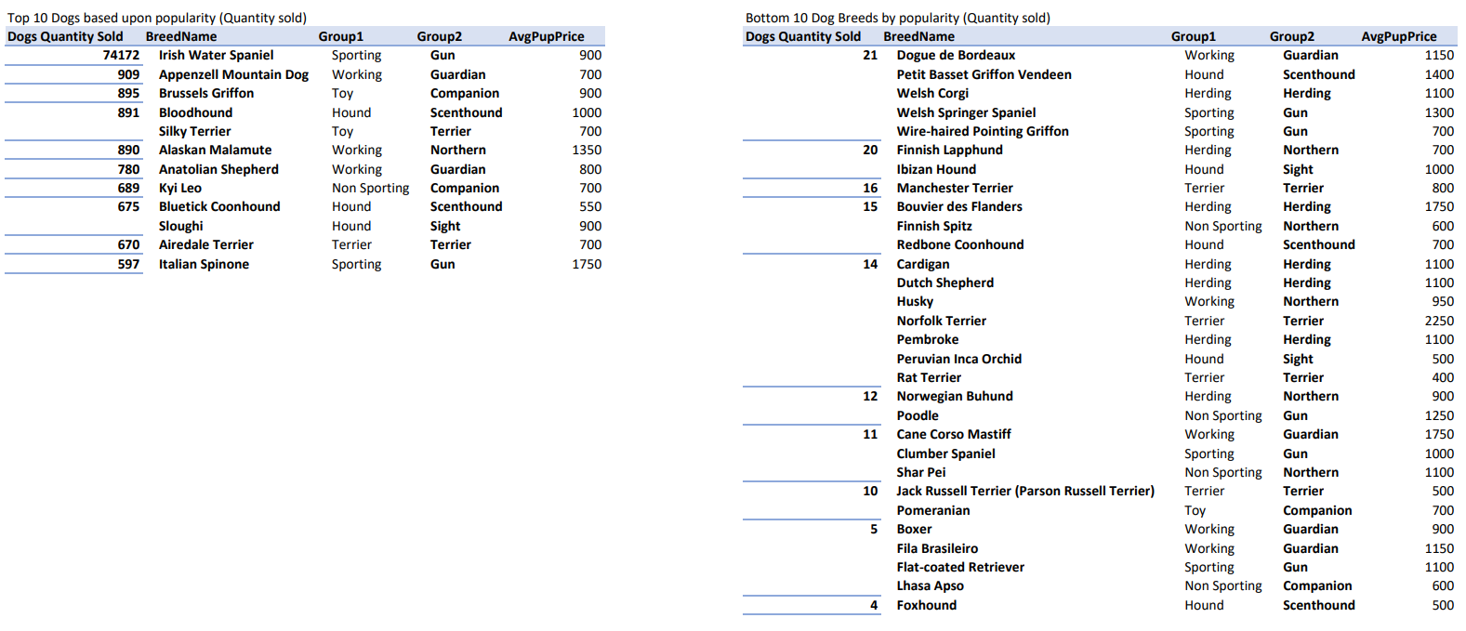
Analysis of Dog Data continued
This leads us to analyse the Top 10 and Bottom 10 Dogs based upon the Quantity Sold

Slide 7
Analysis of Dog Data continued
By looking at the Top 10 Dog Breeds sold, as we have already established that the highest number of Dogs sold is in the Sporting Gun Category, and specifically the Irish Water Spaniel selling 74172. This shows that Hunting Dogs are the most popular by far. The occurrence of the categories in the top 10 are evenly distributed as there are two occurrences of the Sporting Gun, Working Guardian and Hound Scent Hound. All the subcategories in the Toy Category occur, showing that buying for personal reasons is a popular choice. There is also a third appearance of a Working Dog and Hound, being a Northern and Sight Dog respectively.
As far as the prices in the Top 10 are concerned, they are not in the highest price bands except for the Alaskan Malamute (Working Northern) and the Italian Spinone (Sporting Gun).
For the bottom 10 dogs the data shows that Herding sold the most with a total of 110; here are the totals for other categories from Group 1. Hound (74), Sporting (58), Working (56), Terrier (54), Non Sporting (43) and Toy (10). The data here also shows that there is an increased occurrence of breeds in the higher price bracket mainly for the Herding Category.

Slide 8
Analysis of Dog Data continued
I then looked at the top 20 Dog Characteristics with their respective number of occurrences, which are as follows:
1. Intelligent (167) 11. Courageous (41)
2. Alert (94) 12. Lively (35)
3. Loyal (80) 13. Devoted (29)
4. Friendly (75) 14. Fearless (26)
5. Affectionate (72) 15. Loving (26)
6. Playful (54) 16. Trainable (23)
7. Gentle (53) 17. Confident (21)
8. Energetic (48) 18. Obedient (21)
9. Active (46) 19. Responsive (19)
10. Protective (43) 20. Outgoing (18)

Slide 9
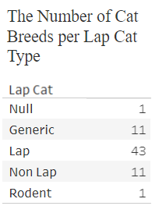
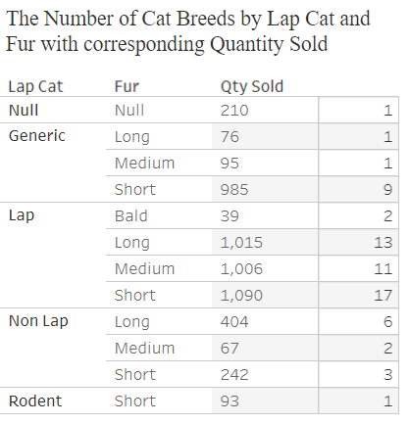
Analysis of Cat Data
I will begin by looking at the Lap Cat Category and I can see that highest number of cat breeds occurs in the Lap category as is shown by the following data.
The second table opposite breaks the data down one step further by incorporating the Fur Category within each Lap Cat Criterion.
As we can see from the Table above we have the most number of breeds in the following sections: Generic-Short, Lap-Long, Lap-Medium, Lap-Short and Non Lap-Long.

Slide 10
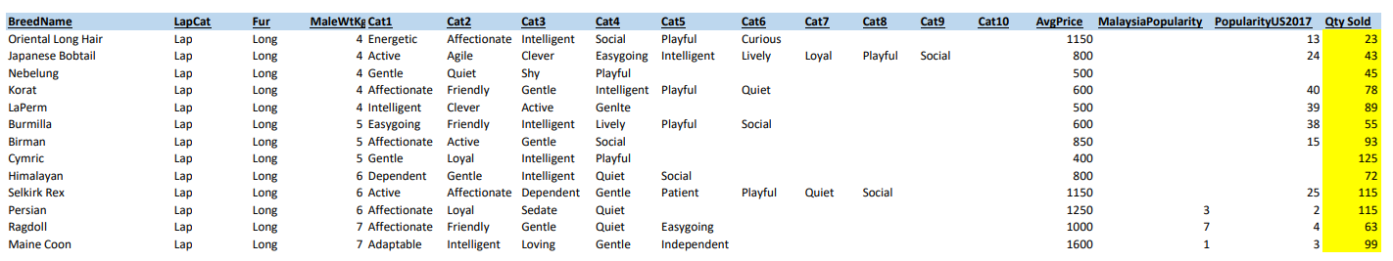
Analysis of Cat Data continued
In the Lap-Long Category shown below, there is more of a correlation between weight and price but it is not completely consistent throughout the data. However, at the higher end of the weight scale the price is also at its highest. Lap-Long Cats are popular in the United States but a small proportion of the quantity sold.
If we look at the temperaments of the Cats in the Lap-Long Category only two breeds are active and one breed is energetic showing that Lap Cats with long hair are less likely to have these characteristics. Furthermore, in the Lap Medium category this observation is even more apparent but in the Lap Short Category the breeds are more active and energetic. This is seen in the data below. The quantity sold for Lap Long Cats is 19.07% of the total sold.

Slide 11
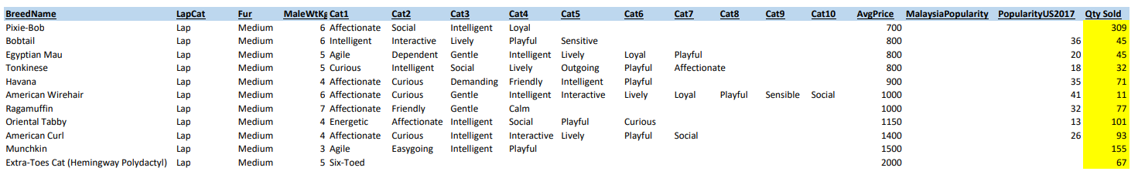
Analysis of Cat Data continued
In the Lap-Medium Category shown below, when ranking the price from lowest to highest, as the price increased I began to notice that the breeds seem to be of a more affectionate temperament, but overall intelligent and not active or energetic. In terms of the number of cats sold in this category, the number sold overall is more or less proportionate to the number sold in the United States and represent 18.90% of the total sold.

Slide 12
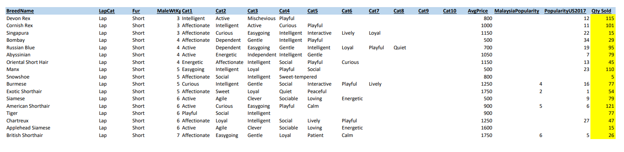
Analysis of Cat Data continued
In the Lap Short Category, the cats here seems to be more affectionate and active, and overall still just as intelligent representing 20.48% of the total sold.

Slide 13
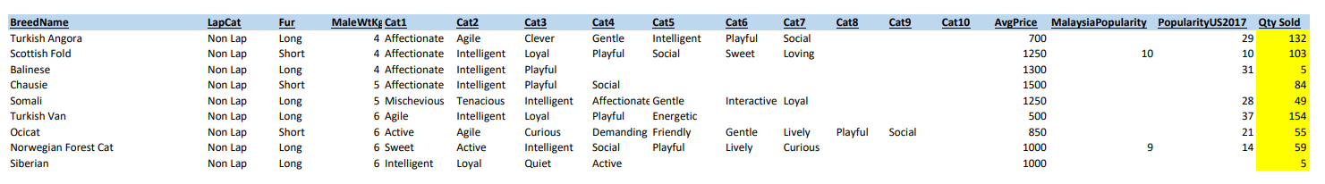
Analysis of Cat Data continued
For the Non Lap Long and Short Categories, the main observation is that the breeds originate from overseas and fall on the whole into the most expensive price band. However, in saying that, the breeds that sold the most in this category were the two cheapest being Turkish Van and Turkish Angora. As far as their temperament is concerned they were affectionate and intelligent throughout but only two breeds were active. The Non Lap Long and the Non Lap Short are 7.59% and 4.55% of the total sold respectively.
Overall, when comparing the quantity sold in the United States in 2017 to the total quantity sold in the each respective Lap subcategory it is more less 20% of the total quantity sold.

Slide 14
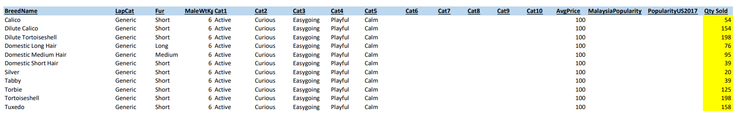
Analysis of Cat Data continued
In the Generic Category shown in the table below, all the breeds have the same weight of 6kg and the same price of £100. In addition to that, they were of the same temperament but not as intelligent and only one breed had long hair. For the breeds that sold the most in this category, the possible reason for this may be based on how nice they look. In terms of the total quantity sold, it is 21.72% of the total.
For each type of Lap Cat the total number sold is as follows: Lap 3150, Generic 1156 and Non Lap 713. This shows that Lap Cats are by far more popular and that price is a decisive factor as Generic Cats costing £100 are the second most popular.

Slide 15
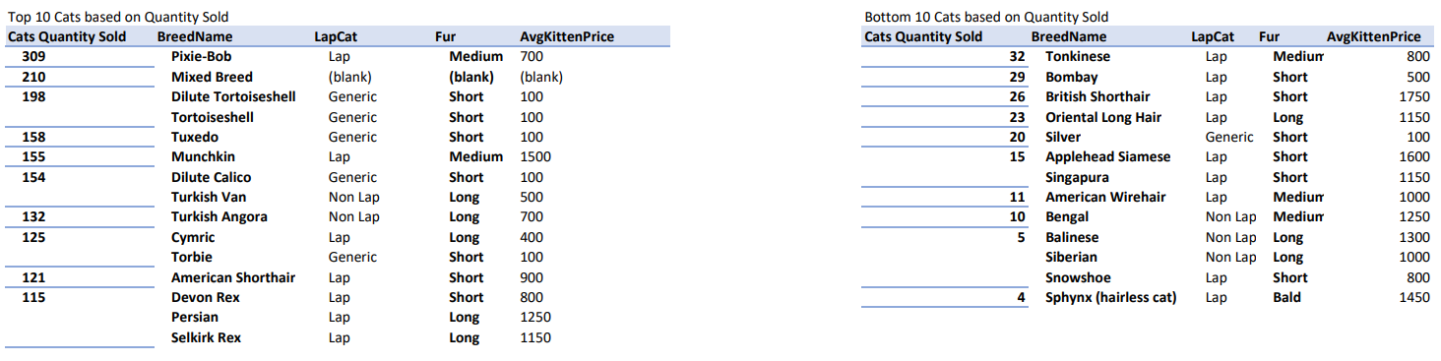
Analysis of Cat Data continued
We now need to look at the top 10 and bottom 10 Cat Breeds
From the Cat Data based on the top 10 Cats sold, there were 5 occurrences of the cheapest Generic variety costing £100, there were 7 occurrences of Lap Cats, where the long haired variety were at the lower end of the top 10 with two in the higher price band(cats with a specific appearance) and one significantly cheaper breed, which was more popular.
The most popular Cat was the Pixie-Bob with characteristics that are consistent with companionship. The second most popular is the Mixed Breed with no specific characteristics or price, where the decision to buy this type of cat is not very clear apart from its hybrid breeding. If we look at the most expensive cats here they all have one thing in common and that is that they have a very unique appearance.
The data here shows that consumers are prepared to pay more money for a specific breed if it meets a certain appearance, has specific characteristics and they are reasonably priced or a combination of these factors. For the bottom 10 cat breeds based on quantity sold, the Lap Cat variety featured and were in the higher price bands. In the Non Lap variety they were also expensive but this seems to be because of their exotic provenance. The cat with no hair is the least popular of all and is in the higher price band.

Slide 16
Analysis of Cat Data continued
I then looked at the characteristics of the cats sold and here are the top 20:
1. Playful (45) 11. Lively (13)
2. Intelligent (38) 12. Quiet (11)
3. Active (28) 13. Agile (9)
4. Affectionate (27) 14. Energetic (8)
5. Curious (24) 15. Friendly (8)
6. Social (22) 16. Interactive (6)
7. Gentle (21) 17. Clever (5)
8. Easy-going (20) 18. Dependent (5)
9. Loyal (18) 19. Loving (4)
10. Calm (14) 20. Sweet (3)

Slide 17
Analysis of Cat Data continued
Dog Summary
Consumers were buying Dogs for a specific purpose as indicated in the Top 10 Dogs sold, which were in the categories Sporting Gun, Working Guardian, Hound Scent Hound, Hound Sight, Toy Companion, Toy Terrier, Non Sporting Companion and Terrier Terrier. This is a very good reflection of the data as whole, however the following categories also sold highly at lower end and they are Herding Herding and Non Sporting Northern. During this process, the data suggests they were also seeking to buy a specific breed as they were willing to spend at the higher price band.
As we can see from the bottom 10 Dogs sold, the buying pattern are relatively the same in terms of buying for a specific purpose, as they predominantly covered the Group 1 and Group 2 categories that occurred for the top 10 breeds, however there were a few exceptions. Also the prices here were overall more expensive prompting the conclusion that price was a factor after all.
There was a three way correlation between Price, Weight and Intelligence. Dogs that weigh more and are more intelligent carry a higher price.
Cat Summary
The highest number of Cats sold is in the Lap Cat Category amounting to 60.24% of total sales. As the Fur Length decreases across this category there is in an increase in the likelihood that the cats will be more active, and are intelligent throughout.
It is also apparent that price is a significant factor when buying cats as the second most popular type of cat is the Generic Cat representing 22.11% of total sales. These Cats weigh and cost the same and have the same characteristics.
The data shows that the type of breed, how it looks, its characteristics and price are a decisive factor. There also seems to be factors that appeal to a consumer’s emotional side. The top 10 characteristics are Playful, Intelligent, Active, Affectionate, Curious, Social, Gentle, Easy-going, Loyal and Calm.

